Slide 1
Meeting Materials for QDrone Project Regular Internal Meeting

Slide 2
Regular Internal Meeting for QDrone Project
Jan 7 2019
4PM at PSE 312
Jungwon Kang, Zahra Arjmandi, Kunwoo Park
Gunho Sohn

Slide 3
Prerequisites for Pursuing Project
Software
Matlab
C++
Ubuntu
ROS
Theory (for backend: state estimation from sensor measurement)
EKF
MSCKF
Smoothing
Sensor
GPS
IMU
Camera
LiDAR

Slide 4
Tasks
Task 0: Building Systems
Task 1: Localization
Task 2: SLAM
Task 3: Navigation

Slide 5
Task 0: Building Systems
Building Complete Systems
Building Systems
Localization & Mapping
Navigation
Done!
DJI M100
(basic setup)
Localization
(range-based)
Navigation
(by just predefined via-point following)
Done!
DJI M100
(payload integration)
SLAM
Navigation
(by next-best-view point selection)
DJI M600 + Gimbal
(basic setup)
DJI M600 + Gimbal
(payload integration)
Simulator

Slide 6
Task 1: Localization
Following Predefined Via-Points
Building Systems
Localization & Mapping
Navigation
DJI M100
(basic setup)
Localization
(range-based)
Navigation
(by just predefined via-point following)
DJI M100
(payload integration)
In-progress
SLAM
Navigation
(by next-best-view point selection)
DJI M600 + Gimbal
(basic setup)
DJI M600 + Gimbal
(payload integration)
Simulator

Slide 7
Task 2: SLAM
Building a Map
Building Systems
Localization & Mapping
Navigation
DJI M100
(basic setup)
Localization
(range-based)
Navigation
(by just predefined via-point following)
DJI M100
(payload integration)
SLAM
Navigation
(by next-best-view point selection)
DJI M600 + Gimbal
(basic setup)
DJI M600 + Gimbal
(payload integration)
Simulator

Slide 8
Task 3: Navigation
Building a Map by Next-Best-View Point Selection
Building Systems
Localization & Mapping
Navigation
DJI M100
(basic setup)
Localization
(range-based)
Navigation
(by just predefined via-point following)
DJI M100
(payload integration)
SLAM
Navigation
(by next-best-view point selection)
DJI M600 + Gimbal
(basic setup)
DJI M600 + Gimbal
(payload integration)
Simulator

Slide 9
Meeting Results: What to do
Common
Basic setup for 'DJI M600 + Gimbal' (primarily by Zahra & Kunwoo)
Booking a PSE 4th floor room equipped with motion capture systems
Zahra
Understanding Kunwoo's EKF-based UWB localization code (including EKF)
Kunwoo
Sending thesis and experiment plan to prof. Sohn
Writing a paper for ISPRS Geospatial Week 2019
Jungwon
Writing a paper for IROS 2019

Slide 10
Future Plan
Jungwon's Rough Suggestion for Future Plan
Zahra (primarily semantic SLAM)
Conventional SLAM
▪ Using vision and/or LiDAR
▪ ORB2
Semantic SLAM
▪ Fusion with deep
Kunwoo (primarily UAV localization)
UWB-Inertial Odometry (UIO)
▪ EKF-based UIO and/or DOP
▪ MSCKF-based UIO and/or DOP
Localization with UIO + GPS switching
Jungwon: supports Kunwoo & Zahra mainly in technical issues.

Slide 11
IMU Calibration Problem
Jan 24 2019
Jungwon Kang, Zahra Arjmandi, Kunwoo Park
Gunho Sohn

Slide 12
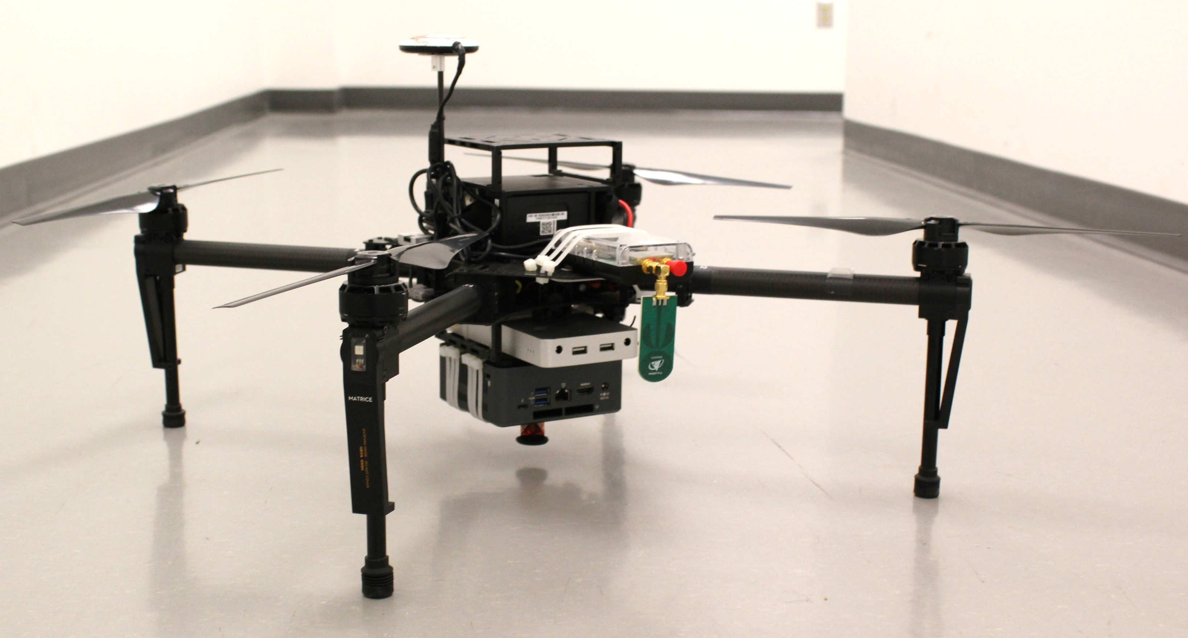
Problem 1
Where is the UWB receiver wrt IMU axis?
IMU Axis
UWB receiver
(Time Domain P440)

Slide 13
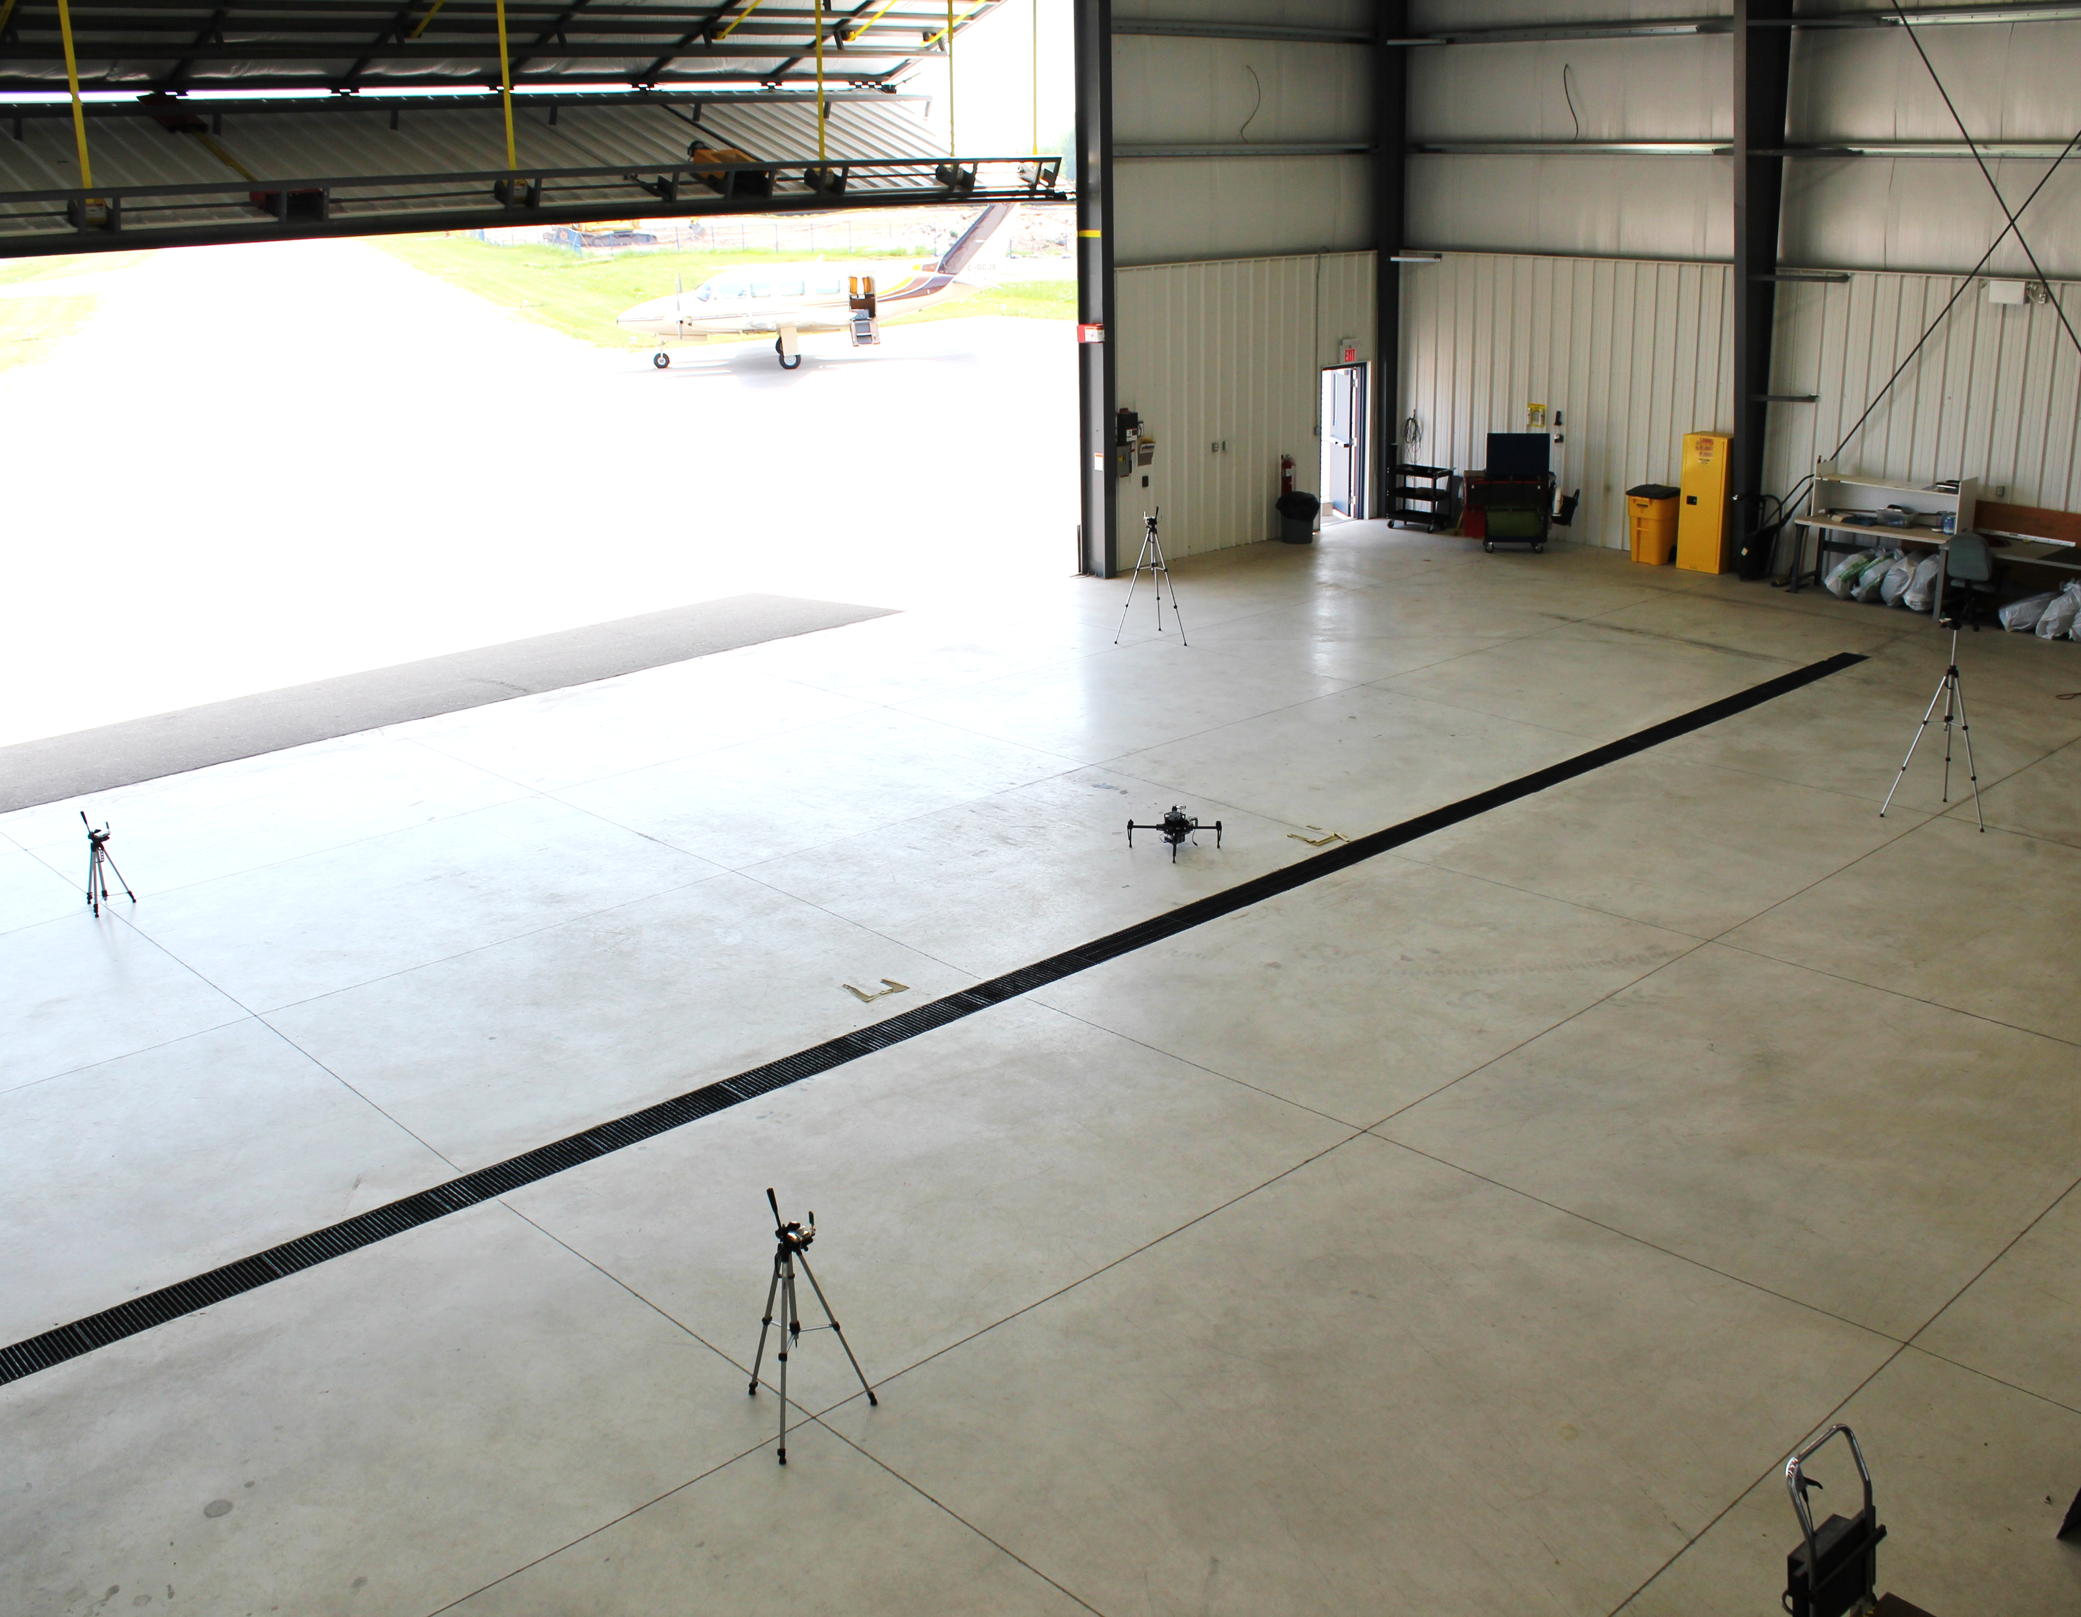
Problem 2
What is the initial R, T between UWB axis and IMU axis?
Z
UWB
102
Y
UAV
UWB
103
UWB
100
X
UWB
101

